Slide 1
CSCI 5229 Final Project John Salame
A Winter Scene

Slide 2
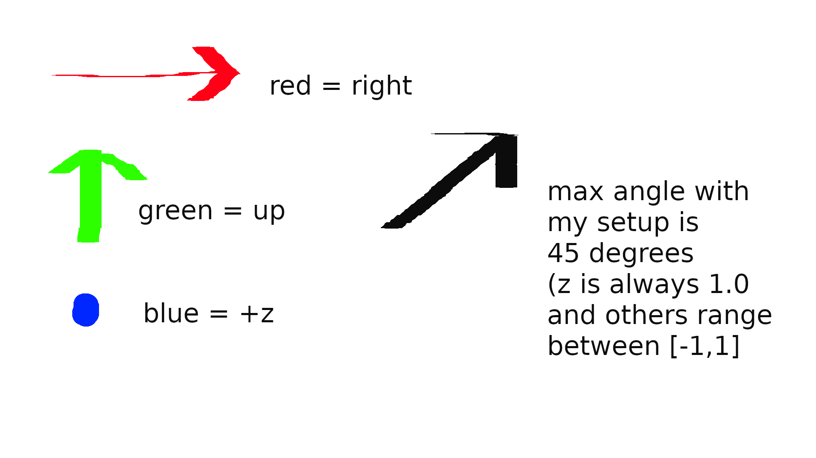

Normal Maps

Slide 3
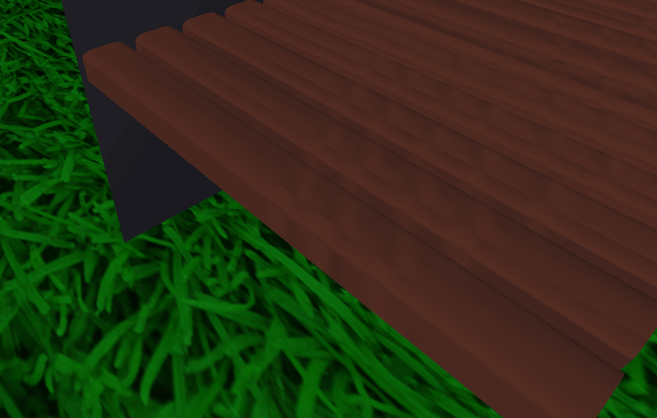
Difficulties – Rendering Errors
Incorrect rendering -
Hard to spot, but shadow is
On wrong side going around
The corner. The Sun hits the
Top from the left, but hits
The side from above, which
Makes shadows show above
The light part of the stipe.

Slide 4
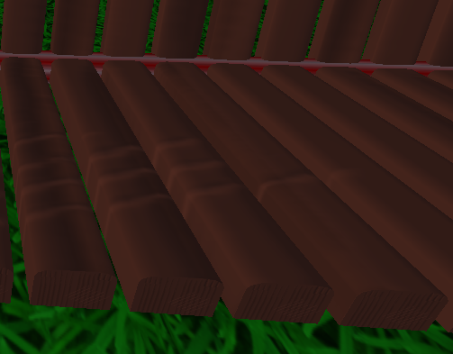
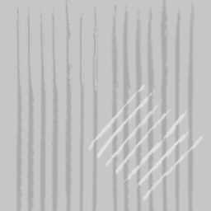
Correct Rendering – Subtle Depressions
Texture used to create
Normal map

Slide 5
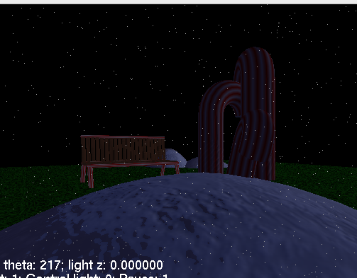
Blizzard
Normal Map visible on snow
Smooth curve underlying geometry
With lighting illusion to look bumpy
Blizzard “snowflakes” dance around
Using noise function seeded by time
And fragment position.
Blizzard is created by a screen
Overlay quad with most fragments
Discarded.

